Slide 1
Smart parking system
AI DRIVEN FACULTY-STUDENT DIFFERENTIATION & REAL TIME SPACE MONITORING

Slide 2
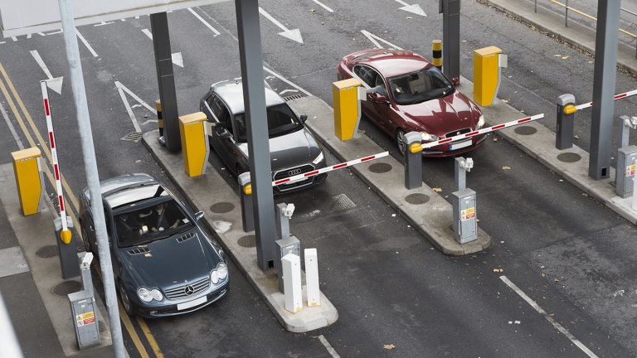
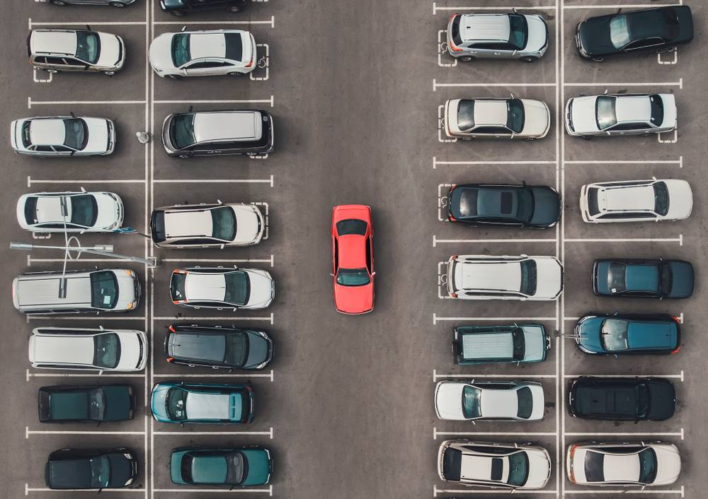
GROUP MEMBERS
Muhammad Samiullah
Muhammad Zohaib Irfan
Rayan Malik

Slide 3
Problem Statement
Inefficient parking systems contribute to urban congestion and inconvenience.
This project addresses the need for a smart parking solution using machine learning to detect and verify license plates of vehicles
The objective is to streamline parking processes, enhance user experience, and contribute to efficient urban parking management.

Slide 4
Aims and Objectives
Eliminate Unauthorized Parking: Distinguish between student and faculty vehicles at entry points, ensuring strict adherence to designated parking areas to eliminate unauthorized parking instances.
Reserved Faculty Parking Management: Implement a robust system for identifying reserved faculty members based on number plate recognition.
Real-time Parking Slot Availability: Monitoring occupancy status in parking lot and display real-time information on a centralized screen at the entrance, guiding incoming vehicles to available parking slots.

Slide 5
Methodology
The methodology for our smart parking system involves integrating license plate detection and ultrasonic sensor-based occupancy monitoring.
After collecting and preprocessing datasets for compatibility, a pretrained deep learning model is fine-tuned to seamlessly integrate ultrasonic sensor data.
The model's detection results are transmitted to the cloud, where an Arduino is coupled to receive instructions, facilitating real-time categorization of parking spaces.
This integration links detected license plates to user profiles, distinguishing between faculty and student parking. The resulting prototype optimizes parking space utilization, providing a seamless and efficient parking experience through cloud-aided communication between the ML model and the Arduino-controlled system.

Slide 6
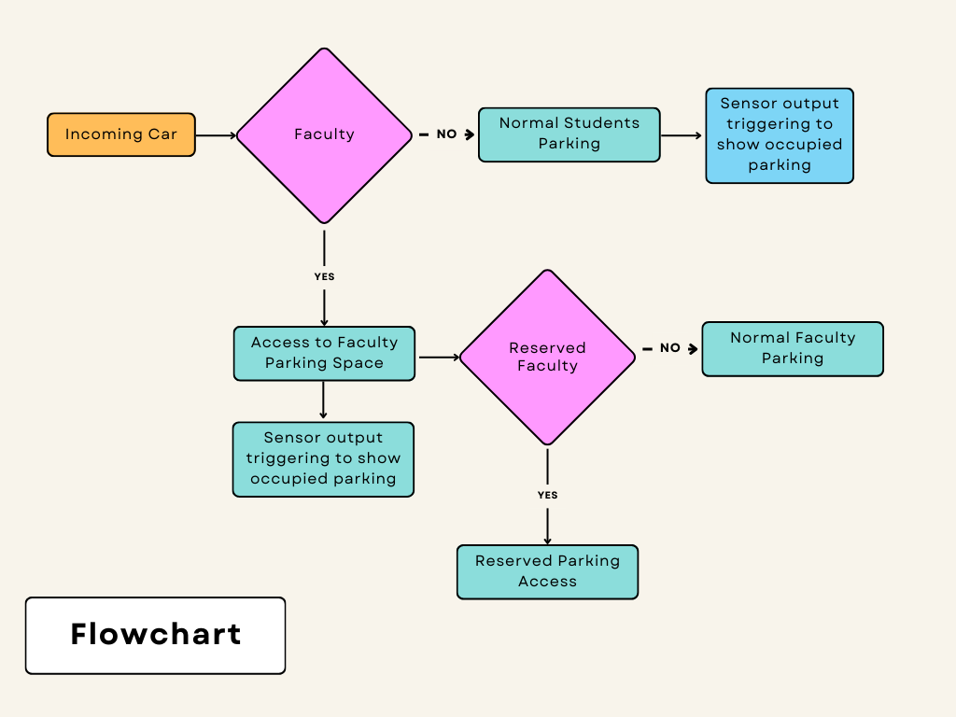
Flowchart

Slide 7
Hardware Prototype

Slide 8

Tools
Arduino
Google Cloud
Google Colab
OpenCV
JavaScript

Slide 9
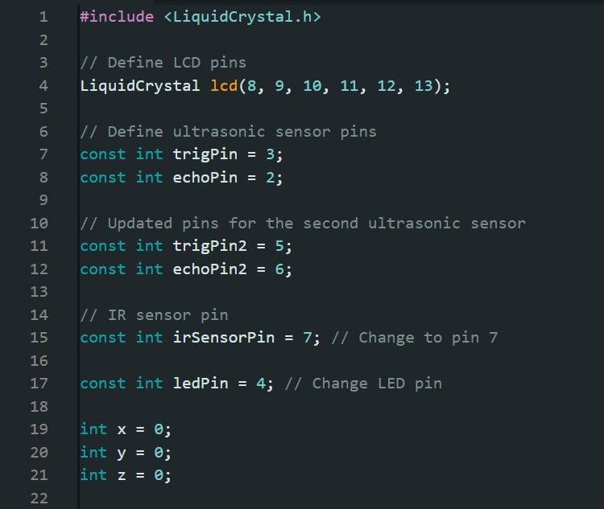
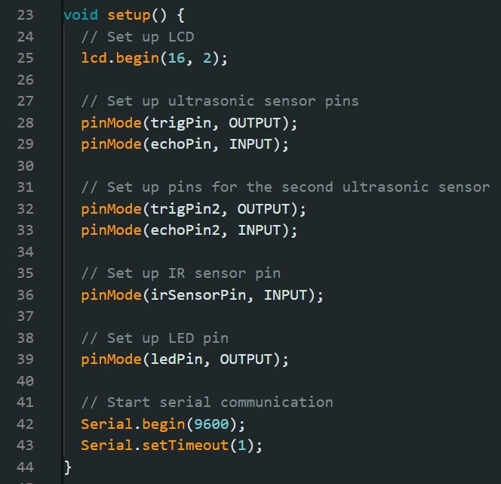
Arduino Code

Slide 10
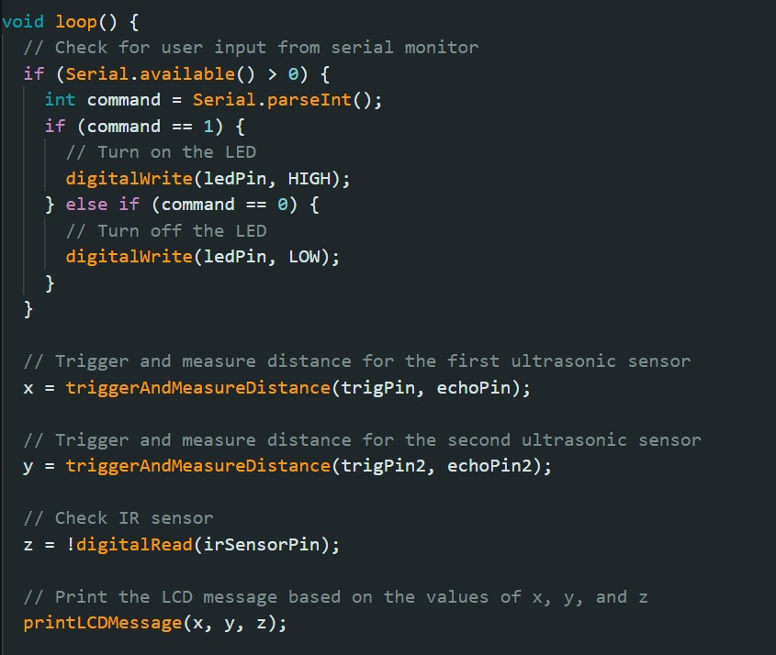
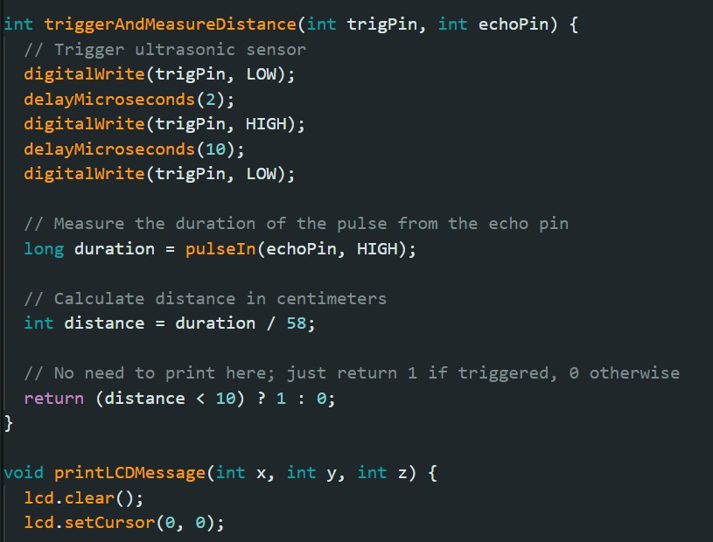

Slide 11
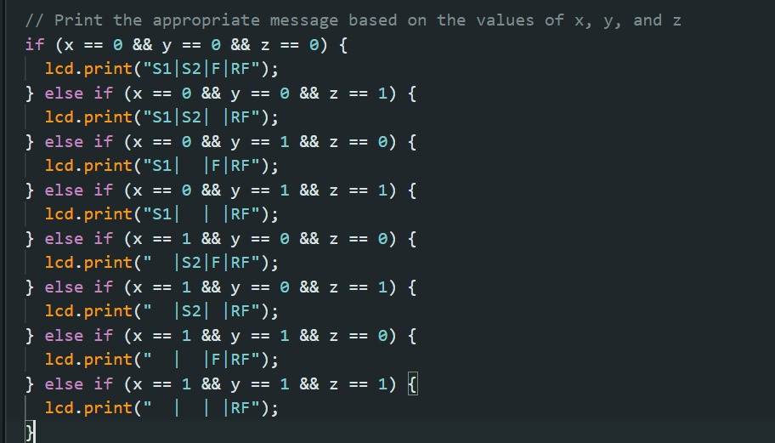

Slide 12
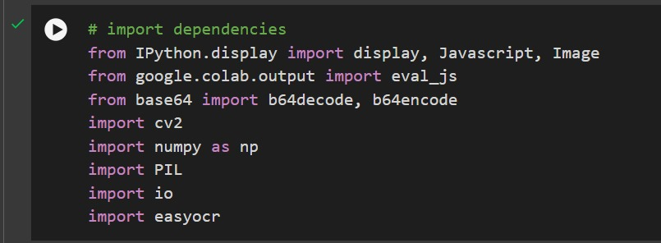
ML Model

Slide 13
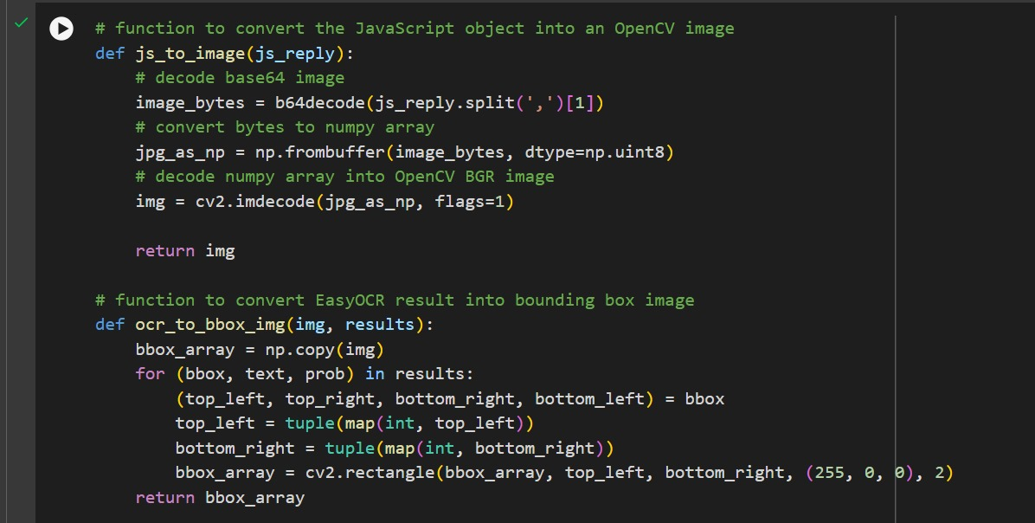

Slide 14
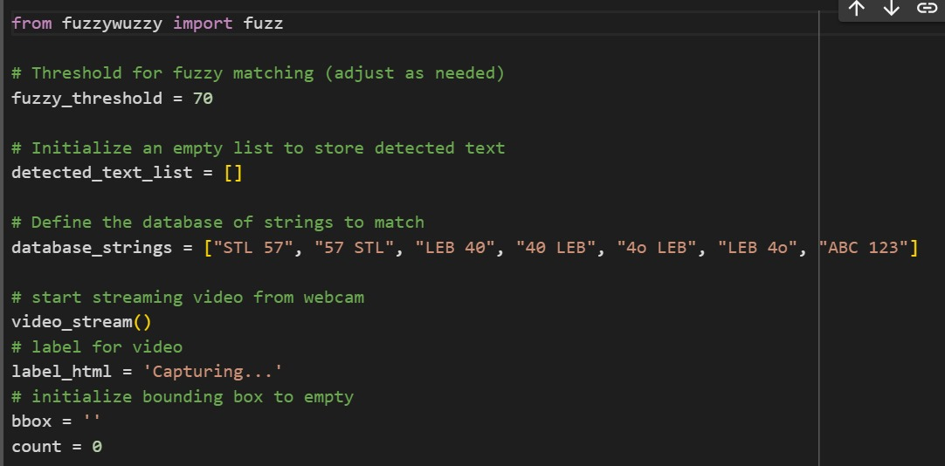

Slide 15
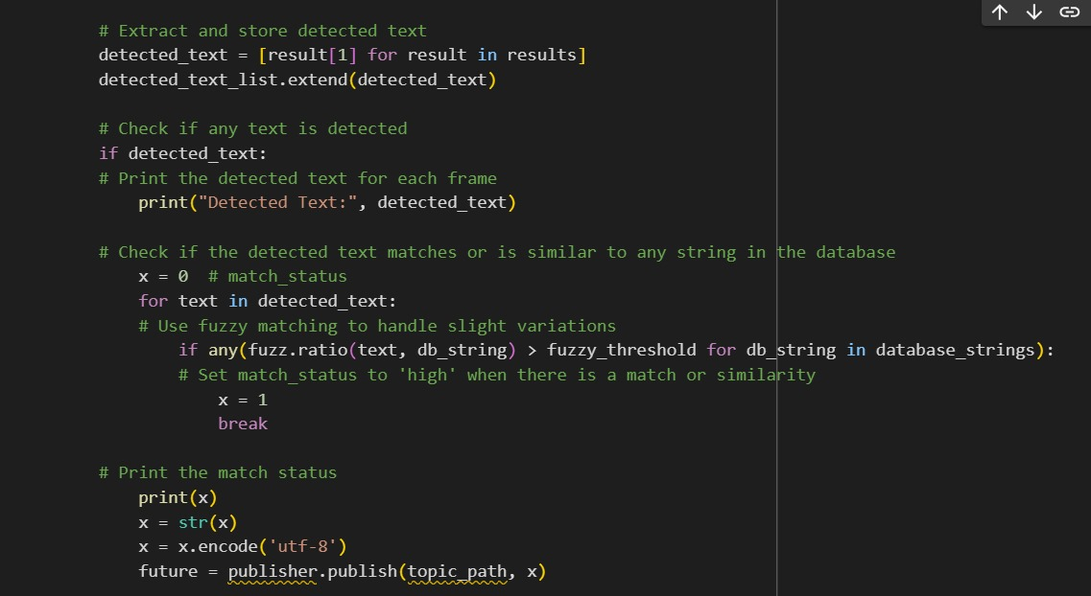

Slide 16
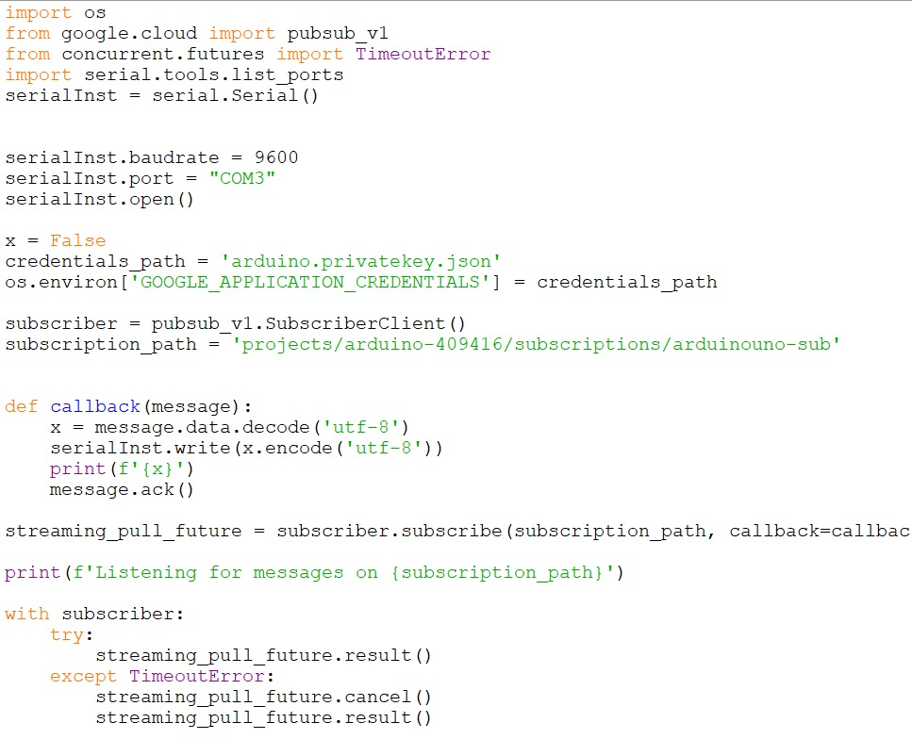
Python-Arduino Binding

Slide 17
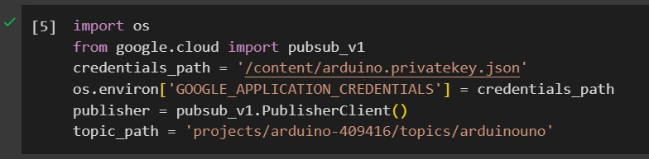
Python-Cloud Binding

Slide 18
Challenges Faced
Limited GPU resources hindered real-time processing, necessitating optimizations.
Integrating cloud resources with ML model and Arduino for seamless transfer of data.

Slide 19
Cost Breakdown
Component | Cost (Rs)
Arduino | 2000
Ultrasonic Sensor (3x) | 1200
LCD Screen | 300
Printing & Poster | 600
Breadboards | 500
Total | 4600

Slide 20




SDGs
SDG 9: Industry, Innovation, and Infrastructure
SDG 11: Sustainable Cities and Communities
SDG 17: Partnerships for the Goals
SDG 13: Climate Action

Slide 21
Conclusion
The Smart Parking System offers an innovative solution to address unauthorized parking and confusion in parking lots.
Utilizing ultrasonic sensors, cameras, and machine learning, the system efficiently identifies faculty and students while pinpointing reserved parking spaces.
The inclusion of a real-time display at the entrance streamlines the parking process, reducing congestion and improving the overall user experience.
Positioned at the intersection of technology and practicality, the project promises a transformative impact on parking management in educational institutions.
With its focus on order, efficiency, and user satisfaction, the Smart Parking System stands out as a solution that enhances the overall parking infrastructure in educational settings.

